Slide 1
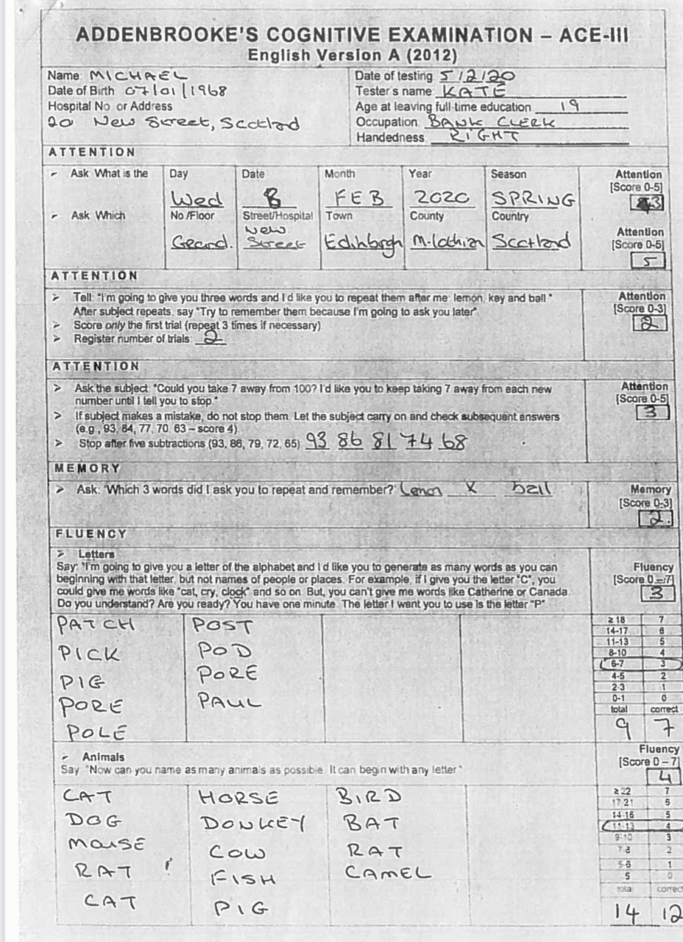
Taking two attempts to register the three words may suggest challenges with sustained attention due to Michael being distracted
Losing track of the subtraction task can suggest challenges with divided attention due to Michael having difficulty keeping his attention on both the current total and number to be subtracted

Slide 2
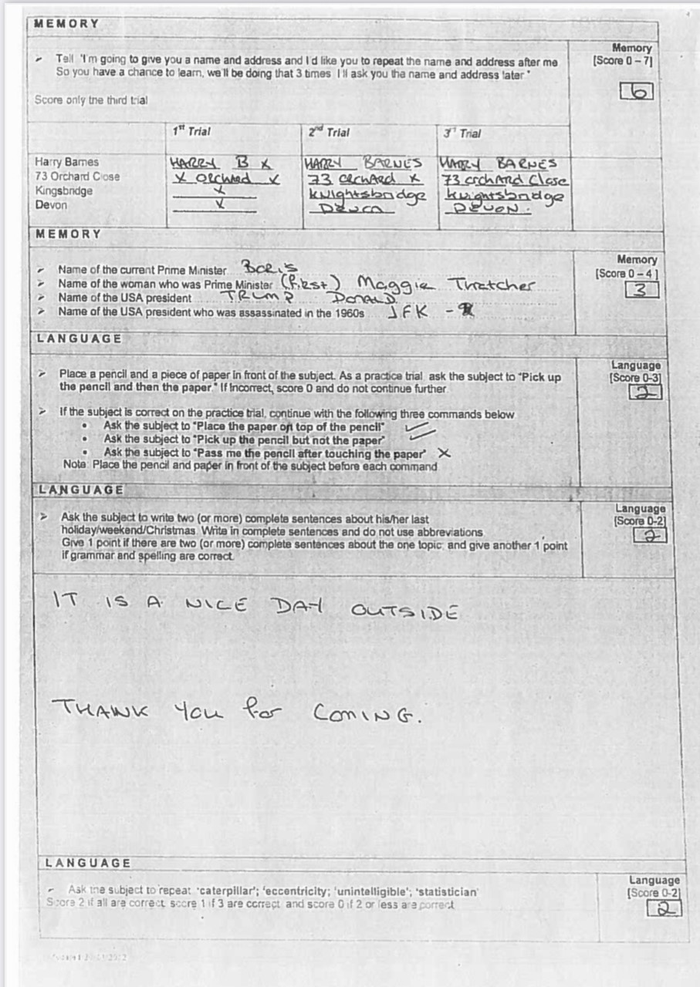

Slide 3
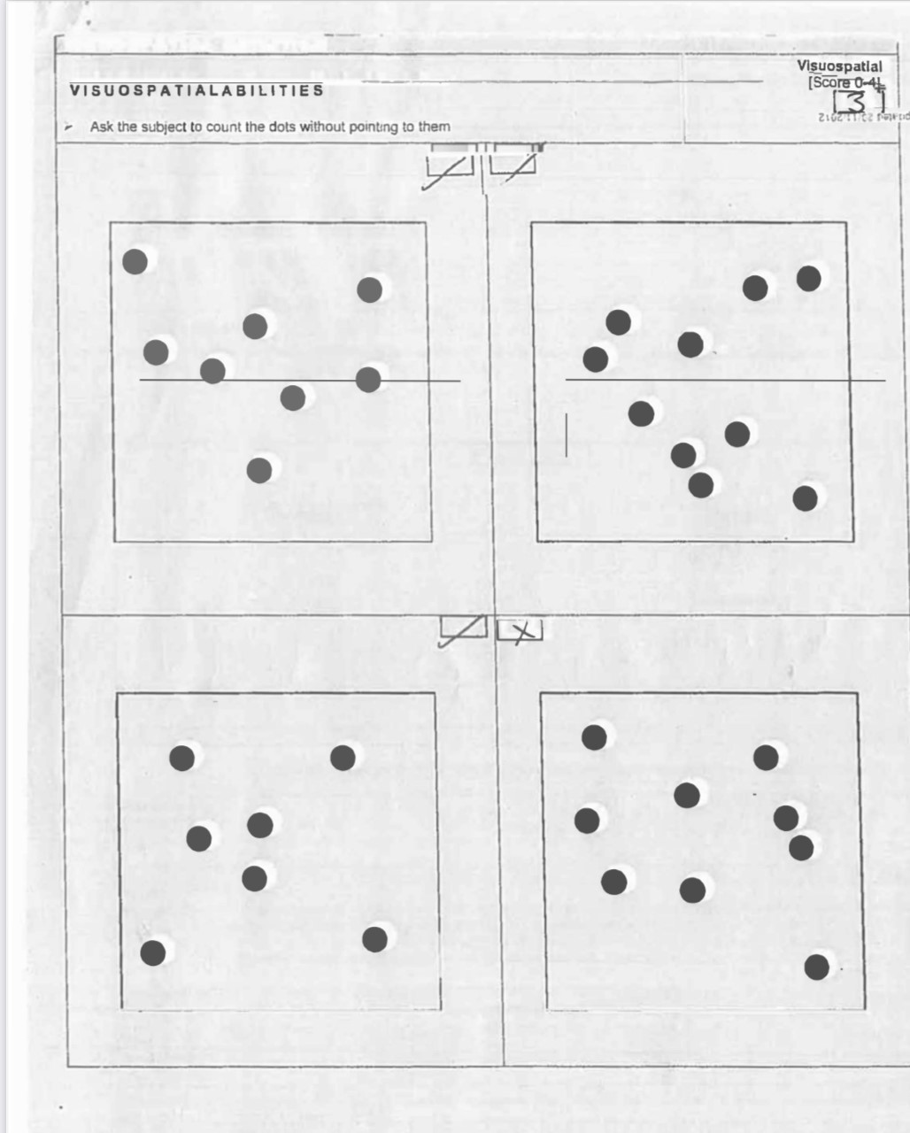
Inaccurate dot counting may suggest decreased sustained attention due to Michael losing track of how many dots have already been counted

